Slide 1
Polymorphism in Python
Week 4

Slide 2
Simple explanation
What is Polymorphism :
The word polymorphism means having many forms.
In programming, polymorphism means same function name (but different signatures) being uses for different types.

Slide 3
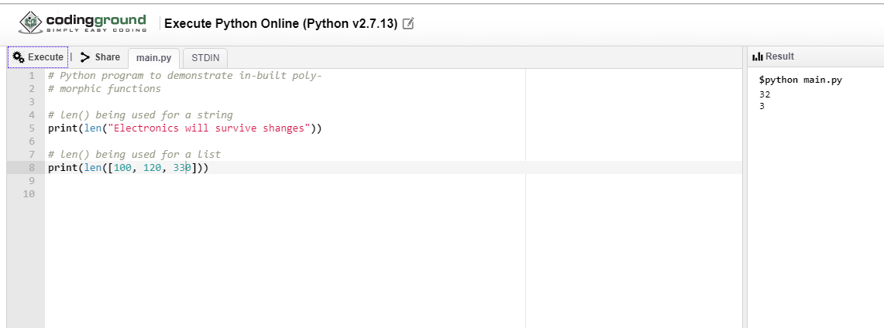
Example of inbuilt polymorphic functions

Slide 4
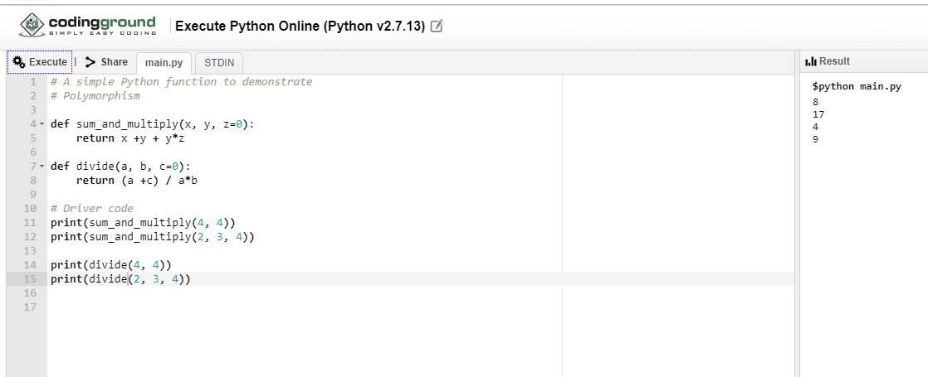
Examples of used defined polymorphic functions :

Slide 5
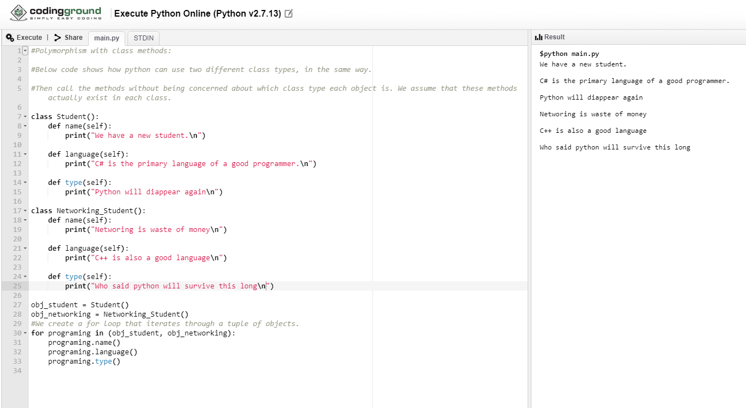
Polymorphism with class methods:

Slide 6
Polymorphism with Inheritance:
DEF:
In Python, Polymorphism lets us define methods in the child class that have the same name as the methods in the parent class.
In inheritance, the child class inherits the methods from the parent class.
However, it is possible to modify a method in a child class that it has inherited from the parent class.
This is particularly useful in cases where the method inherited from the parent class doesn’t quite fit the child class. In such cases, we re-implement the method in the child class.
This process of re-implementing a method in the child class is known as Method Overriding.

Slide 7
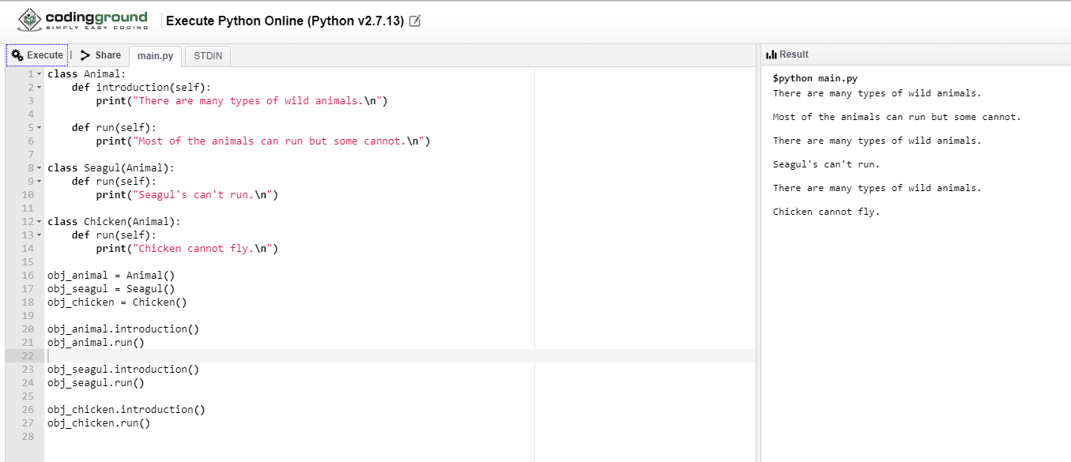
Example
This process of re-implementing a method in the child class is known as Method Overriding. In this example run() method is overridden in the child class

